Slide 1

CS 533 INTRO TO DATA SCIENCE
Michael Ekstrand

Slide 2
SAMPLING DISTRIBUTIONS AND CONFIDENCE INTERVALS

Slide 3

Learning Outcomes
Compute a confidence interval for the mean using the standard error
Correctly interpret a confidence interval
Photo by Ashim D’Silva on Unsplash

Slide 4

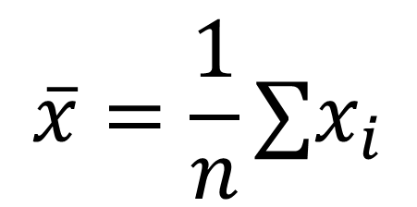
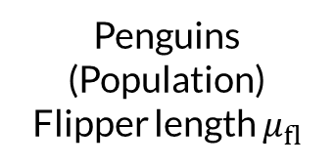
Sampling the Population
Penguins
(Population)
Flipper length $μ_{fl}$
Sample of Penguins
Statistic
$$\overline{x}=\frac{1}{n}∑x_{i}$$

Slide 5
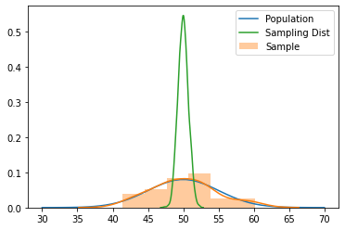

Sampling Distributions
How does a statistic relate to the underlying parameter?
Classical frequentist statistics considers the outcome of repeating the experiment.
This gives us the sampling distribution of the statistic.

Slide 6
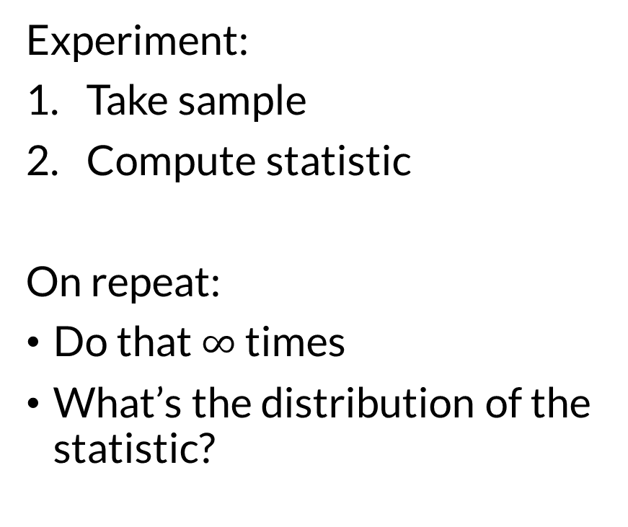
Sampling Distributions
Experiment:
Take sample
Compute statistic
On repeat:
Do that $∞$ times
What’s the distribution of the statistic?

Slide 7
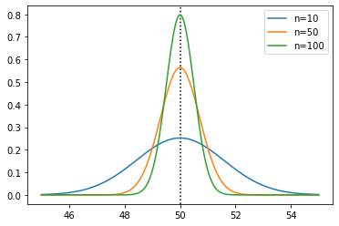
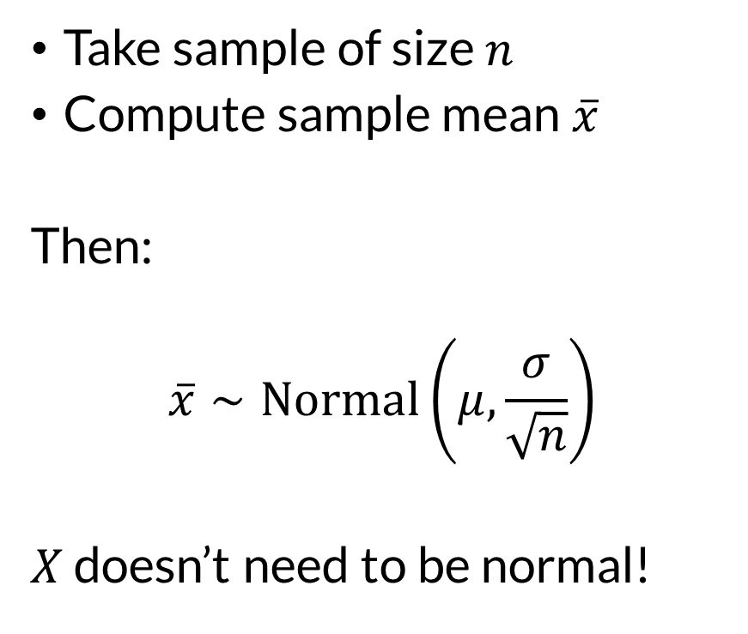
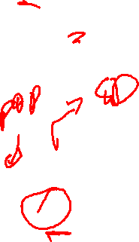
Sampling Distribution of the Sample Mean
Take sample of size $n$
Compute sample mean $\overline{x}$
Then:
$$\overline{x}∼Normal\left(μ,\frac{σ}{\sqrt{n}}\right)$$
$X$ doesn’t need to be normal!

Slide 8
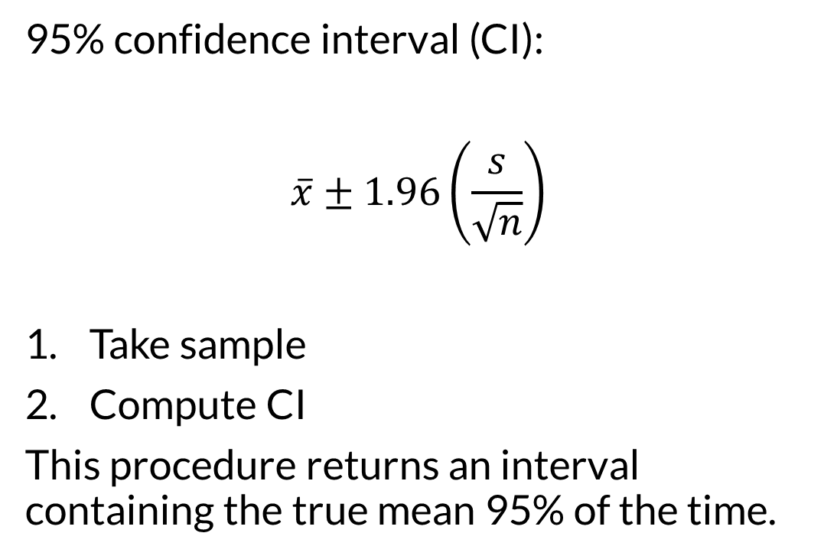
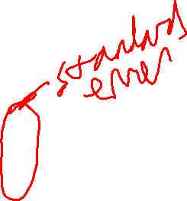
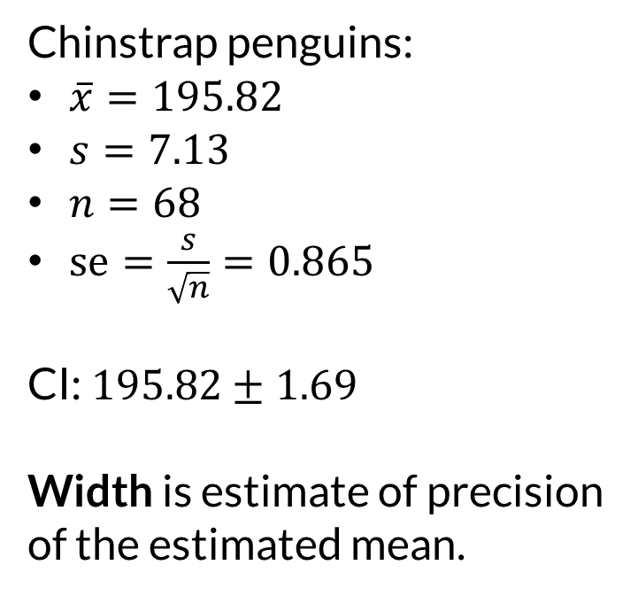
Confidence Interval
95% confidence interval (CI):
$$\overline{x}±1.96\left(\frac{s}{\sqrt{n}}\right)$$
Take sample
Compute CI
This procedure returns an interval containing the true mean 95% of the time.
Chinstrap penguins:
$\overline{x}=195.82$
$s=7.13$
$n=68$
$se=\frac{s}{\sqrt{n}}=0.865$
CI: $195.82±1.69$
Width is estimate of precision of the estimated mean.

Slide 9

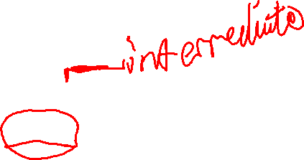
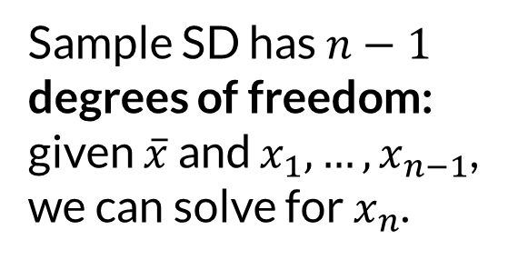
Aside: Pop and Sample SD
Population SD:
$$σ=\sqrt{\frac{∑{\left(x−μ\right)}^{2}}{n}}$$
Sample SD:
$$s=\sqrt{\frac{∑{\left(x−\overline{x}\right)}^{2}}{n−1}}$$
Sample SD has $n−1$ degrees of freedom: given $\overline{x}$ and $x_{1},…,x_{n−1}$, we can solve for $x_{n}$.

Slide 10
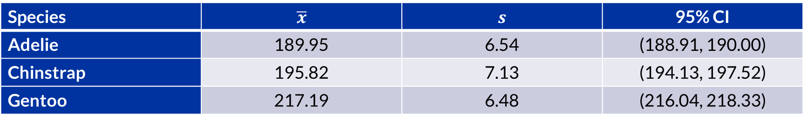
Comparing Confidence
Species | $$\overline{x}$$ | $$s$$ | 95% CI
Adelie | 189.95 | 6.54 | (188.91, 190.00)
Chinstrap | 195.82 | 7.13 | (194.13, 197.52)
Gentoo | 217.19 | 6.48 | (216.04, 218.33)
The confidence intervals do not overlap.
This is evidence that the species have different flipper lengths.
We’ll see a direct comparison later.

Slide 11
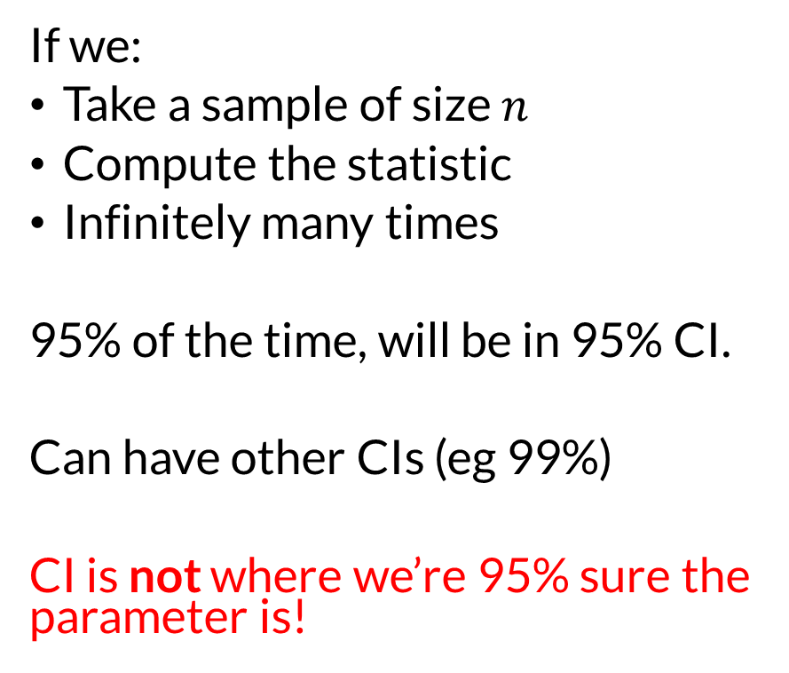
Interpreting Confidence
If we:
Take a sample of size $n$
Compute the statistic
Infinitely many times
95% of the time, will be in 95% CI.
Can have other CIs (eg 99%)
CI is not where we’re 95% sure the parameter is!

Slide 12
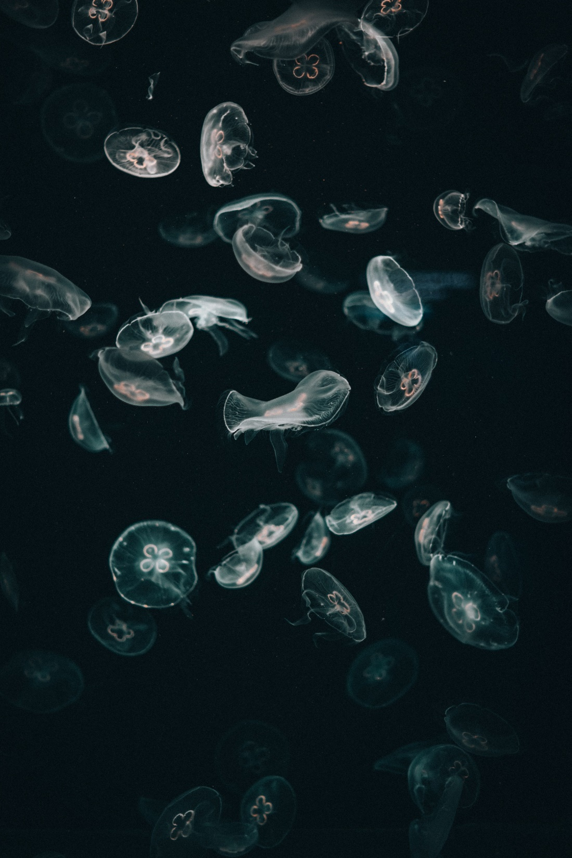
Wrapping Up
Taking a sample and computing a statistic is a random process that results in a sampling distribution.
We can use the sampling distribution to estimate the precision of an estimate (e.g. statistic estimating a parameter).
Photo by Joshua Rawson-Harris on Unsplash

